Slide 1
Application Layer

Slide 2
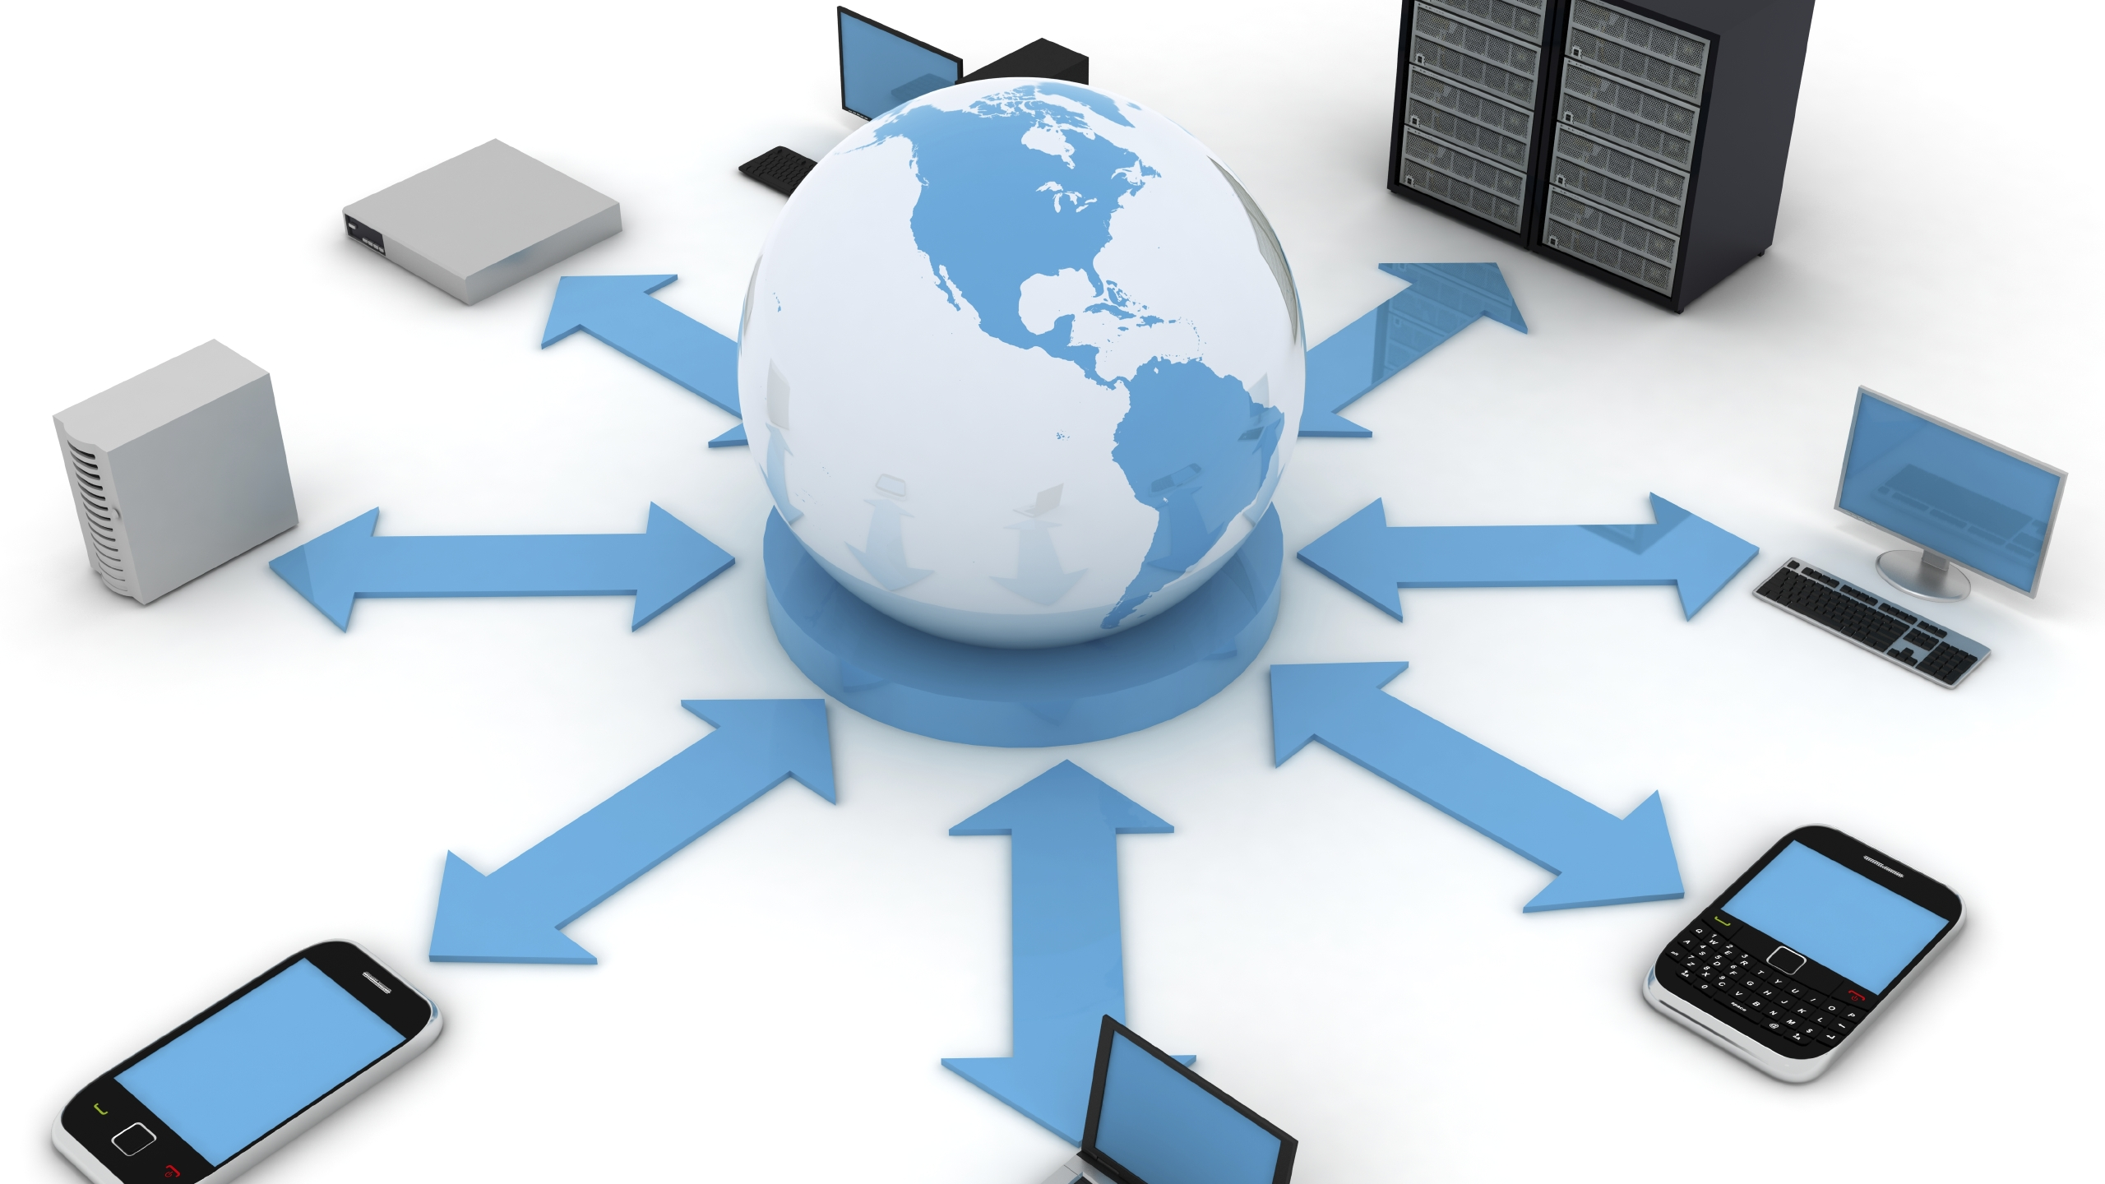
Notes:
When we’re developing a networked application, we write programs that:
Run on (different) end systems
Communicate over the network
e.g. web server software communicates with browser software
There’s no need to write software for the network-core devices
They don’t run user applications
Applications on end systems allow for rapid app development and propagation
The architecture of an application are either client-server or peer to peer (P2P)

Slide 3

Notes:
Client – server architecture
The server is an always-on host, generally with a permanent IP address and often hosted in data centers.
Some consideration needs to be given over to scaling the server side – so we may end up with multiple servers in different locations serving different geographical regions!
Clients communicate with the server and may only be connected intermittently with dynamic IP addresses, they do not communicate with each other directly.

Slide 4
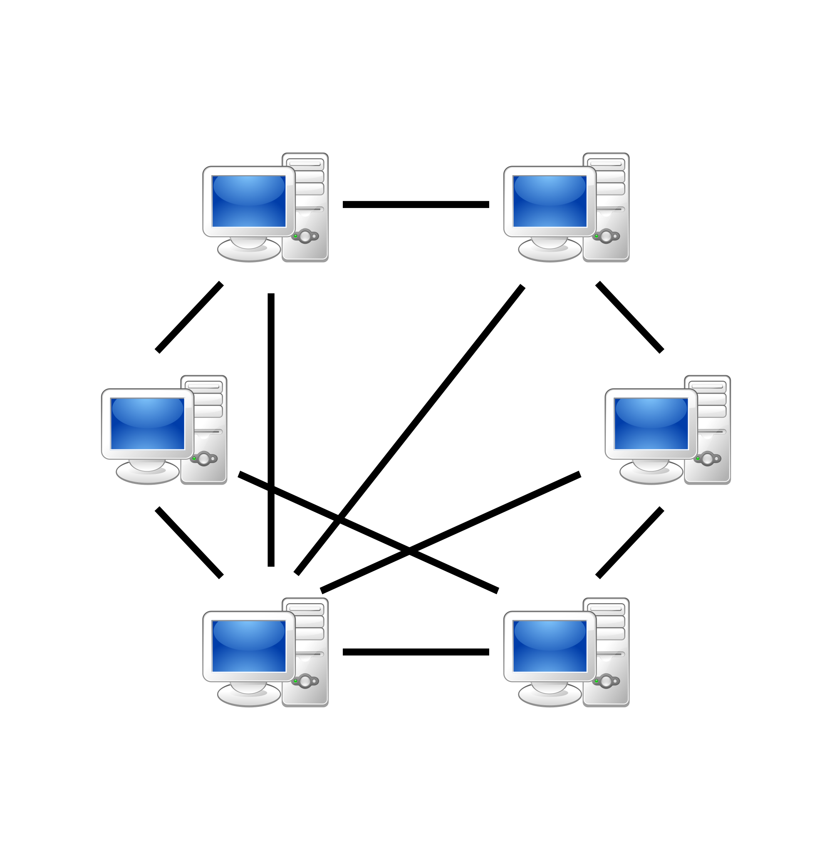
Notes:
A P2P architecture has no always on server, instead arbitrary end systems communicate directly.
Peers request service from other peers and provide service in return.
This is self-scaling, new peers bring with them service capacity as well as service demands.
Peers are intermittently connected and change IP addresses, which complicates management of the system.
Older console games are P2P (hence host migration) – BitTorrent is P2P too.

Slide 5

Notes:
Processes are applications running on a host machine (a host could be a client or a server) within the same host, two processes communicate using inter-process communication at the OS level.
Processes on different hosts communicate by exchanging messages.
A client process initiates communication, a server process waits to be contacted.
P2P architectures have client and server processes in one host.

Slide 6

IP Address
Port
195.195.221.31
80
2001:0db8:85a3:0000:0000:8a2e:0370:7334
80
Notes:
Processes send and receive messages to / from its socket.
A socket is analogous to a letter
Sending process drops letter in post box
Relies on transport infrastructure (postal system) to deliver message to socket at receiving process
To manage that, we need to know where to deliver the message, hosts must have an identifier.
In this case, a host has either a 32-bit IP address (IPV4) or a 128-bit IP address (IPV6), this gets us to the host, but we need a way of identifying the process on that host to deliver the message to.
We do this by including a port number, HTTP generally runs on port 80, mail servers on 25 etc.

Slide 7

Notes:
The App-layer protocol defines the:
Types of messages exchanged – e.g. request, response
Message syntax – what fields are in messages and how fields are delineated
Message semantics – meanings of information in fields
Rules for when and how processes send and respond to messages
Some protocols are open and defined in RFCs (requests for comment)
This allows for interoperability across different systems and implementations
HTTP, SMTP are open and define
Other protocols are closed and their definitions are not released to the public (but they can be discovered!)
- Skype is a closed protocol – it does not work (is not interoptable) with other protocols.

Slide 8
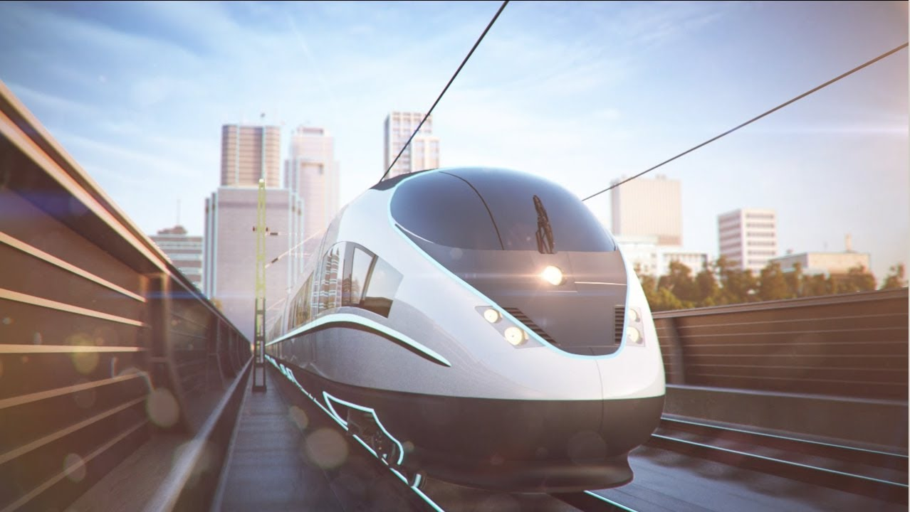
TCP
UDP
Reliable Transport
Reliable Transport
Flow Control
Flow Control
Congestion Control
Congestion Control
Timing
Timing
Minimum Throughput
Minimum Throughput
Security
Security
Notes:
There are two main transport protocols, TCP and UDP.
TCP has:
Reliable transport between processes
Flow control so the sender won’t overwhelm the receiver
Congestion control so the sender is throttled when the network gets overloaded
It does not provide timing, minimum throughput or security
It requires a connection to be setup between client and server processes.
UDP provides an unreliable data transfer and it does not provide any of the other things that TCP offers!
So why bother? TCP is used when we have to guarantee delivery of packets; UDP allows us to just throw packets into the network and not care if they arrive or not.

Slide 9

Client
Server
Create socket to server
Requests web object
Accepts connection
Close connection
Returns requested object (or 404)
Notes:
The HTTP protocol is an example of an application protocol that we can find out everything about as it’s specified in an open RFC.
It uses a client / server model
The client (your browser) requests (using the http protocol), receives and displays web objects
The server sends (using http) objects in response to requests
It uses TCP and the process looks something like this:
HTTP is stateless – the server maintains no information about past requests from the client.
Maintaining state is complex – past history has to be maintained and if the server or client crash then their views of the “state” may be inconsistent and have to be reconciled.

Slide 10
Client
Server
Create socket to server
Requests web object
Accepts connection
Close connection
Returns requested object (or 404)
Notes:
Each step in this process has a response time associated with it – the RTT (round trip delay time) is the time for a small packet to travel from the client to the server and back.
HTTP connections can be either non-persistent or persistent.
A persistent connection means the server leaves the connection open after sending the response, so subsequent HTTP requests are sent over the open connection
This reduces the number of RTT to as little as one for all the referenced objects.
A non-persistent connection requires the server to open and close a socket / connection for each and every request, greatly increasing the number RTTs

Slide 11
status line
(protocol
status code
status phrase)
HTTP/1.1 200 OK\r\n
Date: Sun, 26 Sep 2010 20:09:20 GMT\r\n
Server: Apache/2.0.52 (CentOS)\r\n
Last-Modified: Tue, 30 Oct 2007 17:00:02 GMT\r\n
ETag: "17dc6-a5c-bf716880"\r\n
Accept-Ranges: bytes\r\n
Content-Length: 2652\r\n
Keep-Alive: timeout=10, max=100\r\n
Connection: Keep-Alive\r\n
Content-Type: text/html; charset=ISO-8859-1\r\n
\r\n
data data data data data ...
header
lines
data, e.g.,
requested
HTML file
Notes:
There are two types of HTTP message, a request and a response
The response message looks like this, one of the most important elements here is the status code – in this example it’s 200 OK
But it could be something like 404 NOT FOUND or 400 BAD REQUEST.
Because request and response messages are written in ASCII, you can communicate directly with a web server via telnet – just connect to the domain name via port 80 and type an HTTP request message in, just be sure to tap enter twice to finalise the message and send it.

Slide 12
carriage return character
request line
(GET, POST,
HEAD commands)
line-feed character
GET /index.html HTTP/1.1\r\n
Host: www-net.cs.umass.edu\r\n
User-Agent: Firefox/3.6.10\r\n
Accept: text/html,application/xhtml+xml\r\n
Accept-Language: en-us,en;q=0.5\r\n
Accept-Encoding: gzip,deflate\r\n
Accept-Charset: ISO-8859-1,utf-8;q=0.7\r\n
Keep-Alive: 115\r\n
Connection: keep-alive\r\n
\r\n
header
lines
carriage return,
line feed at start
of line indicates
end of header lines
Notes:
There are two types of HTTP message, a request and a response
The HTTP request message is human readable (represented by ASCII)
It includes:
the request line
Request header fields

Slide 13
Client
Server
Create sends line to server
Receives data and converts to uppercase
Displays modified line on screen
Sends data to client
Notes:
Socket programming:
Goal – learn to build client / server applications that communicate using sockets
Remember that the socket acts like a post box / pigeon hole for messages we send.
So a basic application might go something like this:
Client reads a line of characters from the keyboard and sends data to server
Server receives the data and converts characters to uppercase
Server send modified data to the client
Client receives modified data and displays the line on the screen

Slide 14
UDP
Server
Client
Create socket on port x
Create socket on port x
Write datagram to socket
Read datagram from socket
Write reply to socket, specifying address
Read datagram from socket
Notes:
Socket programming with UDP There is no “connection” between the client & server:
No identification prior to sending data
Sender explicitly attaches IP destination and port # to each packet
Receiver extracts IP address and port# from received packet
UDP may transmit data out of order or it may be lost completely!
So UDP provides unreliable transfer of groups of bytes (datagrams) between hosts.

Slide 15
include Python’s socket
library
from socket import *
serverName = ‘hostname’
serverPort = 12000
clientSocket = socket(AF_INET,
SOCK_DGRAM)
message = raw_input(’Input lowercase sentence:’)
clientSocket.sendto(message.encode(),
(serverName, serverPort))
modifiedMessage, serverAddress =
clientSocket.recvfrom(2048)
print modifiedMessage.decode()
clientSocket.close()
create UDP socket for server
get user keyboard
input
Attach server name, port to message; send into socket
print out received string and close socket
Notes:
In python, this looks something like this for the Client:

Slide 16
from socket import *
serverPort = 12000
serverSocket = socket(AF_INET, SOCK_DGRAM)
serverSocket.bind(('', serverPort))
print (“The server is ready to receive”)
while True:
message, clientAddress = serverSocket.recvfrom(2048)
modifiedMessage = message.decode().upper()
serverSocket.sendto(modifiedMessage.encode(),
clientAddress)
create UDP socket
bind socket to local port number 12000
loop forever
Read from UDP socket into message, getting client’s address (client IP and port)
send upper case string back to this client
Notes:
And something like this for the server.

Slide 17
TCP
Server
Client
Create socket on port x
Wait for incoming requests
Create socket on port x
Connect to server
Read request from socket
Send request to socket
Write reply to socket
Read reply from socket
Close socket
Close socket
Notes:
On the other hand, TCP requires a different approach The client must contact the server
So the server process has to be running
Server must have created a socket that welcomes clients contact
Clients contact the server by:
Creating TCP socket, specifying IP address and port number of server
When client creates socket, client TCP established connection to server TCP
When the server is contacted by a client, it creates a new socket to communicate with that particular client
This allows the server to talk to multiple clients, using port numbers to distinguish between them.

Slide 18
from socket import *
serverName = ’servername’
serverPort = 12000
clientSocket = socket(AF_INET, SOCK_STREAM)
clientSocket.connect((serverName,serverPort))
sentence = raw_input(‘Input lowercase sentence:’)
clientSocket.send(sentence.encode())
modifiedSentence = clientSocket.recv(1024)
print (‘From Server:’, modifiedSentence.decode())
clientSocket.close()
create TCP socket for server, remote port 12000
No need to attach server name, port
Notes:
Which looks like this in Python for the client

Slide 19
from socket import *
serverPort = 12000
serverSocket = socket(AF_INET,SOCK_STREAM)
serverSocket.bind((‘’,serverPort))
serverSocket.listen(1)
print ‘The server is ready to receive’
while True:
connectionSocket, addr = serverSocket.accept()
sentence = connectionSocket.recv(1024).decode()
capitalizedSentence = sentence.upper()
connectionSocket.send(capitalizedSentence.
encode())
connectionSocket.close()
create TCP welcoming
socket
server begins listening for incoming TCP requests
loop forever
server waits on accept()
for incoming requests, new socket created on return
read bytes from socket (but not address as in UDP)
close connection to this client (but not welcoming socket)
Notes:
And this on the server

